Slide 1
Applied Data Science Machine Learning in Python
Dr. Omri Allouche
2017

Slide 2
Homework
Read https://www.oreilly.com/ideas/intro-to-scikit-learn
Read http://amueller.github.io/sklearn_tutorial/
Watch https://github.com/justmarkham/scikit-learn-videos

Slide 3
SciKit Learn
Most popular ML library on Python
Many algorithms
Clean & uniform API
Features matrix – rows are observations, columns are features
Target array
Consistent structure, uses an estimator object with methods fit, predict, score
Sensible defaults for each algorithm

Slide 4
SKLEARN Workflow
Choose a class of model by importing the appropriate estimator class from Scikit-Learn.
Choose model hyperparameters by instantiating this class with desired values.
Arrange data into a features matrix and target vector following the discussion above.
Fit the model to your data by calling the fit() method of the model instance.
Apply the Model to new data:
For supervised learning, often we predict labels for unknown data using the predict() method.
For unsupervised learning, we often transform or infer properties of the data using the transform() or predict() method.

Slide 5

Choosing an Algorithm

Slide 6
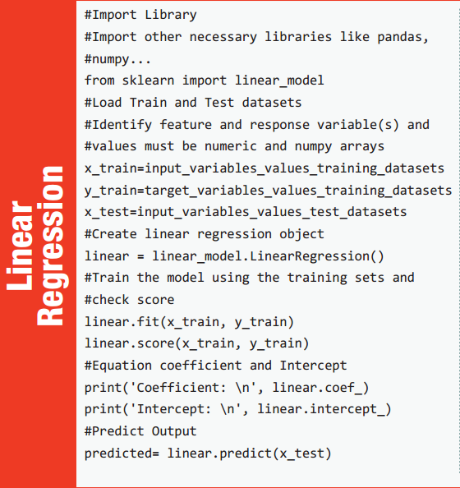
Notes:
https://www.analyticsvidhya.com/wp-content/uploads/2016/08/MLalgorithms-.pdf

Slide 7
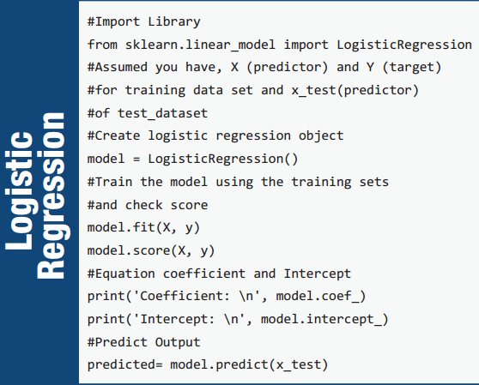

Slide 8
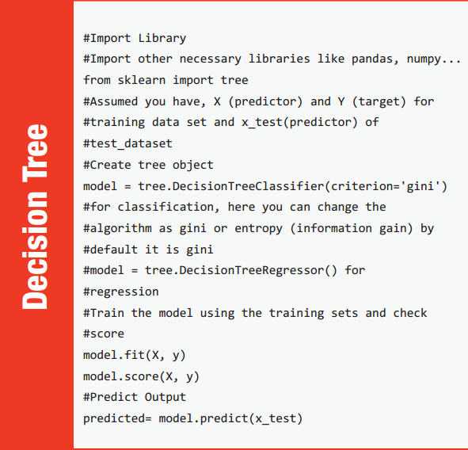

Slide 9
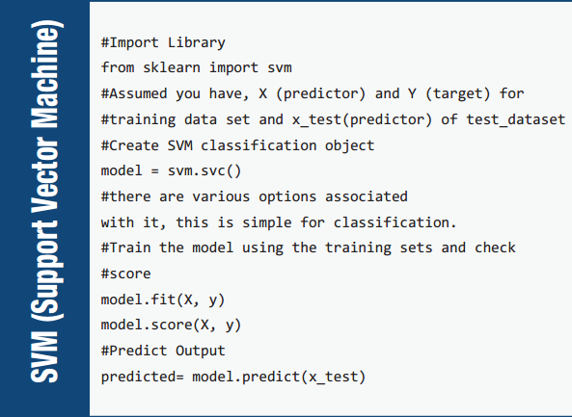

Slide 10
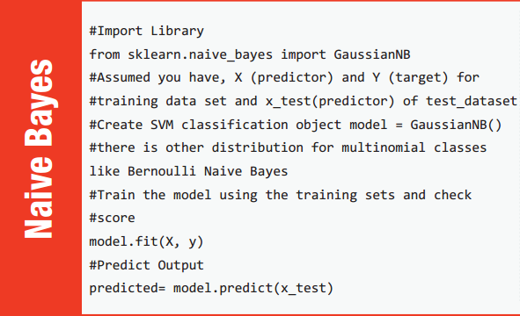

Slide 11
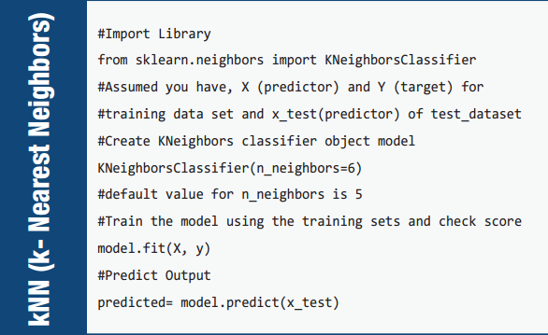

Slide 12
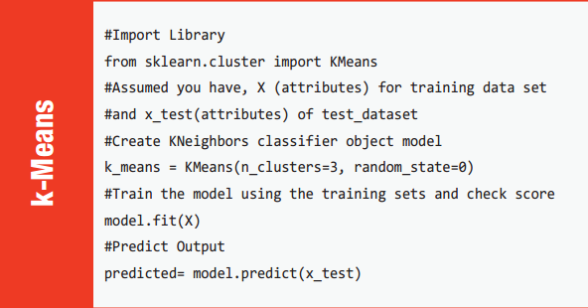

Slide 13
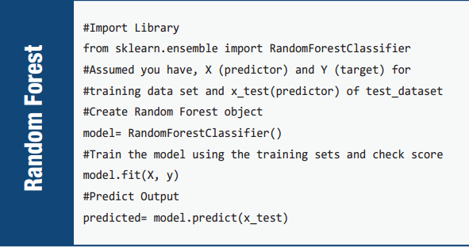

Slide 14
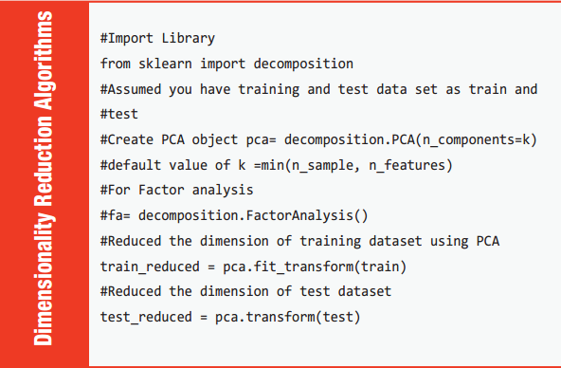

Slide 15
Successful Learning
Factors important for a successful learning:
Enough examples
Examples represent population
Model is powerful enough
Model isn’t “too powerful”

Slide 16
Classification

Slide 17
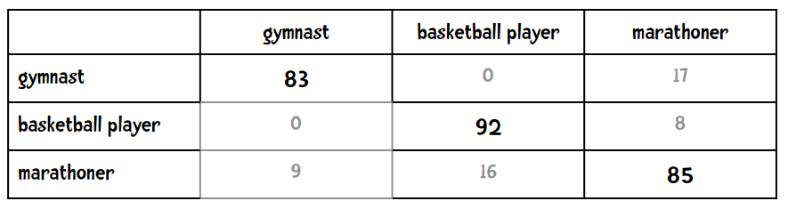
Confusion Matrix

Slide 18
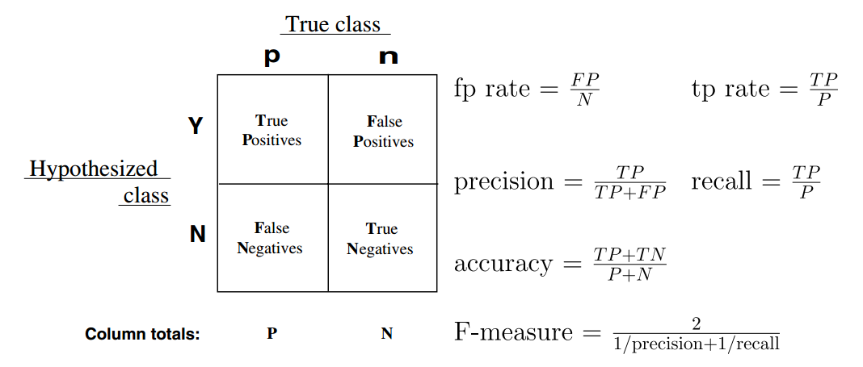

Slide 19
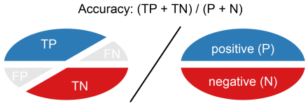
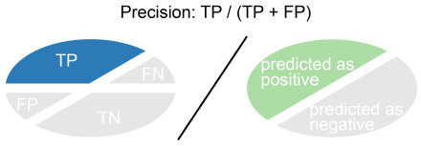
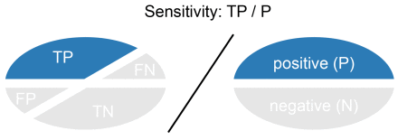
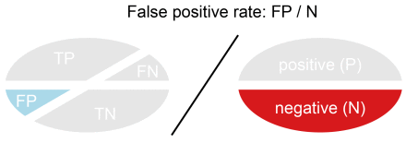
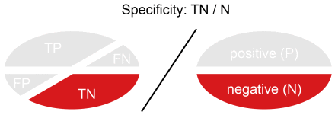
aka Recall, True Positive Rate
aka True Negative Rate

Slide 20
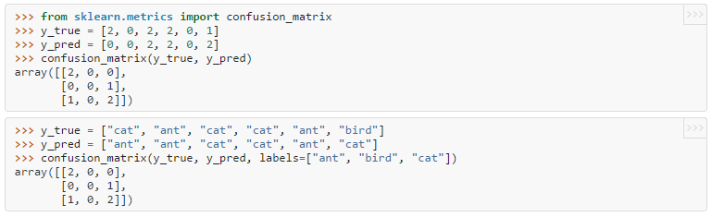
Confusion Matrix in SKLEARN

Slide 21
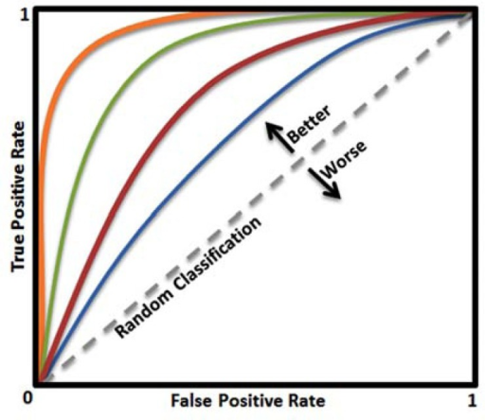
ROC – Receiver Operating Curve

Slide 22
Classification Evaluation Measures
callable string function
accuracy sklearn.metrics.accuracy_score
precision sklearn.metrics.precision_score
recall sklearn.metrics.recall_score
f1 sklearn.metrics.f1_score
roc_auc sklearn.metrics.roc_auc_score
kappa sklearn.metrics.cohen_kappa_score

Slide 23
Train/Test Split

Slide 24
Train/Test Split
Why is it important?
How do we expect error to behave for different % of splits?
Types of splits:
Single
k-fold Cross-validation
Leave-one-out
Stratification
What are the pros and cons of each?
Pay attention to randomness!

Slide 25
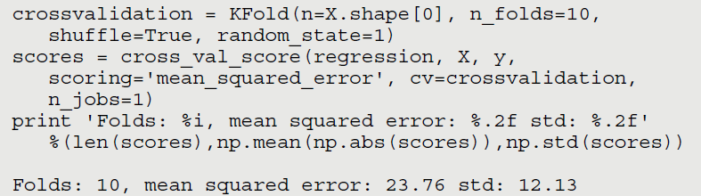
Cross Validation – k-fold

Slide 26
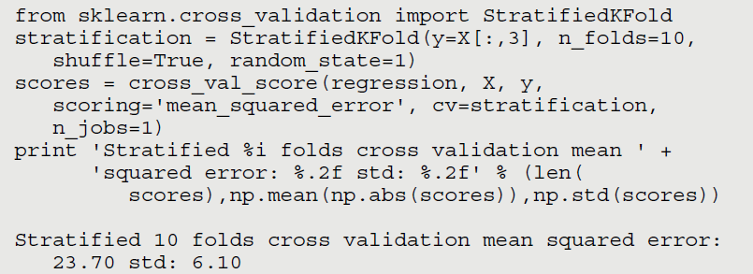
Sampling Stratification
Consider distribution when sampling, to prevent malformed samples

Slide 27
Overfitting, Underfitting and The Bias-Variance Tradeoff

Slide 28
Generalization
Bias: how much the average model over all training sets differ from the true model?
Error due to inaccurate assumptions/simplifications made by the model
Variance: how much models estimated from different training sets differ from each other
Underfitting: model is too “simple” to represent all the relevant class characteristics
High bias and low variance
High training error and high test error
Overfitting: model is too “complex” and fits irrelevant characteristics (noise) in the data
Low bias and high variance
Low training error and high test error
Slide credit: L. Lazebnik

Slide 29
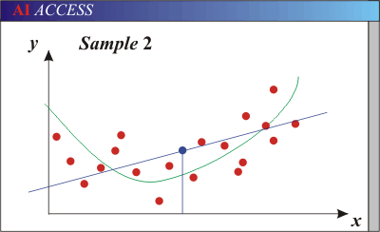
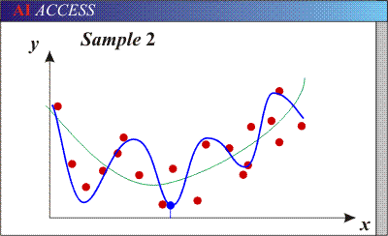
Bias-Variance Trade-off
Models with too few parameters are inaccurate because of a large bias (not enough flexibility).
Models with too many parameters are inaccurate because of a large variance (too much sensitivity to the sample).
Slide credit: D. Hoiem
Notes:
http://www.aiaccess.net/English/Glossaries/GlosMod/e_gm_bias_variance.htm

Slide 30
Bias-Variance Trade-off
E(MSE) = noise² + bias² + variance
Error due to variance of training samples
Unavoidable error
Error due to incorrect assumptions
See the following for explanations of bias-variance (also Bishop’s “Neural Networks” book):
http://www.inf.ed.ac.uk/teaching/courses/mlsc/Notes/Lecture4/BiasVariance.pdf
Slide credit: D. Hoiem
Notes:
From the link above:
You can only get generalization through assumptions.
Thus in order to minimize the MSE, we need to minimize both
the bias and the variance. However, this is not trivial to do this. For instance, just
neglecting the input data and predicting the output somehow (e.g., just a constant), would definitely minimize the variance of our predictions: they would be
always the same, thus the variance would be zero—but the bias of our estimate
(i.e., the amount we are off the real function) would be tremendously large. On
the other hand, the neural network could perfectly interpolate the training data,
i.e., it predict y=t for every data point. This will make the bias term vanish entirely, since the E(y)=f (insert this above into the squared bias term to verify this),
but the variance term will become equal to the variance of the noise, which may
be significant (see also Bishop Chapter 9 and the Geman et al. Paper). In general,
finding an optimal bias-variance tradeoff is hard, but acceptable solutions can be
found, e.g., by means of cross validation or regularization.

Slide 31
How to reduce variance?
Choose a simpler classifier
Regularize the parameters
Get more training data
Slide credit: D. Hoiem
Notes:
The simpler classifier or regularization could increase bias and lead to more error.

Slide 32
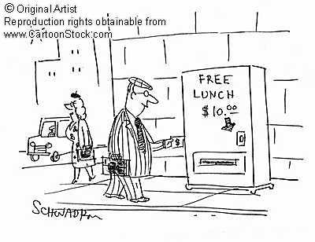
What to remember about classifiers
No free lunch: machine learning algorithms are tools, not dogmas
Try simple classifiers first
Better to have smart features and simple classifiers than simple features and smart classifiers
Use increasingly powerful classifiers with more training data (bias-variance tradeoff)
Slide credit: D. Hoiem

Slide 33
Continuous outcome (means)
Outcome Variable | Are the observations independent or correlated? |  | Alternatives if the normality assumption is violated (and small sample size):
 | independent | correlated
Continuous (e.g. pain scale, cognitive function) | Ttest: compares means between two independent groups ANOVA: compares means between more than two independent groups Pearson’s correlation coefficient (linear correlation): shows linear correlation between two continuous variables Linear regression: multivariate regression technique used when the outcome is continuous; gives slopes | Paired ttest: compares means between two related groups (e.g., the same subjects before and after) Repeated-measures ANOVA: compares changes over time in the means of two or more groups (repeated measurements) Mixed models/GEE modeling: multivariate regression techniques to compare changes over time between two or more groups; gives rate of change over time | Non-parametric statistics Wilcoxon sign-rank test: non-parametric alternative to the paired ttest Wilcoxon sum-rank test (=Mann-Whitney U test): non-parametric alternative to the ttest Kruskal-Wallis test: non-parametric alternative to ANOVA Spearman rank correlation coefficient: non-parametric alternative to Pearson’s correlation coefficient

Slide 34
Binary or categorical outcomes (proportions)
Outcome Variable | Are the observations correlated? |  | Alternative to the chi-square test if sparse cells:
 | independent | correlated
Binary or categorical (e.g. fracture, yes/no) | Chi-square test: compares proportions between two or more groups Relative risks: odds ratios or risk ratios Logistic regression: multivariate technique used when outcome is binary; gives multivariate-adjusted odds ratios | McNemar’s chi-square test: compares binary outcome between correlated groups (e.g., before and after) Conditional logistic regression: multivariate regression technique for a binary outcome when groups are correlated (e.g., matched data) GEE modeling: multivariate regression technique for a binary outcome when groups are correlated (e.g., repeated measures) | Fisher’s exact test: compares proportions between independent groups when there are sparse data (some cells <5). McNemar’s exact test: compares proportions between correlated groups when there are sparse data (some cells <5).

Slide 35
Generative vs. Discriminative Classifiers
Generative Models
Discriminative Models
Represent both the data and the labels
Often, makes use of conditional independence and priors
Examples
Naïve Bayes classifier
Bayesian network
Models of data may apply to future prediction problems
Learn to directly predict the labels from the data
Often, assume a simple boundary (e.g., linear)
Examples
Logistic regression
SVM
Boosted decision trees
Often easier to predict a label from the data than to model the data
Slide credit: D. Hoiem
Notes:
Generative classifiers try to model the data. Discriminative classifiers try to predict the label.

